Slide 1
BAN 5753 Mini Project 2
Team Artemis

Slide 2

Team
Amartya
Mitra
Mihir Shinde
Bhakti Saoji
Tanushree
Ghosh

Slide 3
Agenda
Introduction
Problem Statement
EDA
Modelling
Insights
Recommendation
Conclusion

Slide 4
Goals and Objectives
Problem Statement:
The goal is to predict if the client will subscribe to a term deposit using classification models
Objectives:
Exploring Dataset
Predicting Clients that will subscribe
Finding Important Variables
Recommendations
Concept: A term deposit is a cash investment to a financial institution for an agreed interest rate over a fixed time period

Slide 5
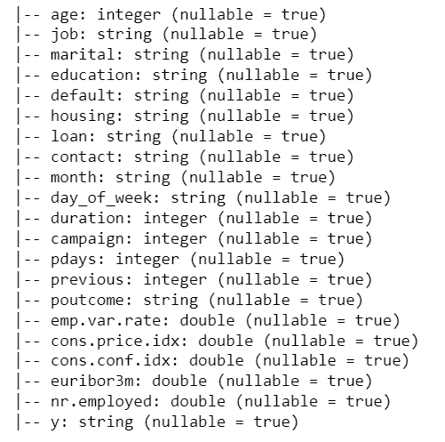
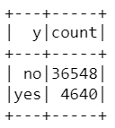
Exploratory Data Analysis
Data Overview:
Number of Rows: 41188
Number of Columns: 21
There is no missing data in any columns
The dataset is highly imbalanced where the client who subscribes account for 11.2% of the overall data

Slide 6
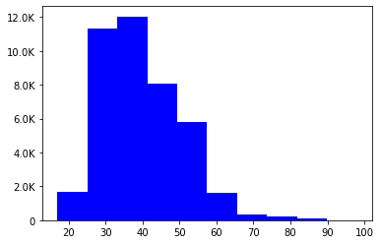
Exploratory Data Analysis
Age – Bar Plot
The distribution seems close to normal distribution
There seems to be a lot more clients in the age group of 25-40 years
The average age of clients is 41 years
Notes:
This is a univariate analysis of age.

Slide 7
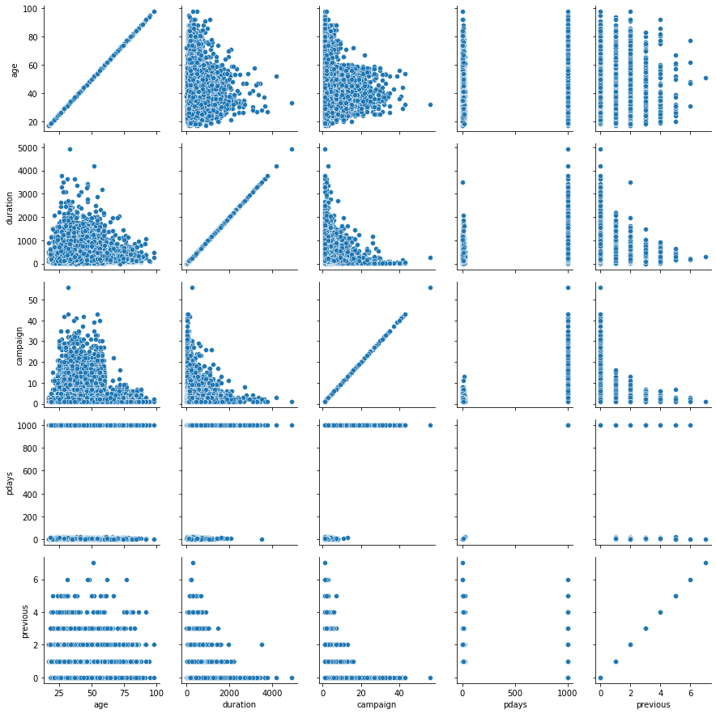
Exploratory Data Analysis
By visual inspection,
Duration is negatively correlated to campaign
Age is negatively corelated to duration and campaign
The distribution of age for people previously contacted vs new clients is similar

Slide 8
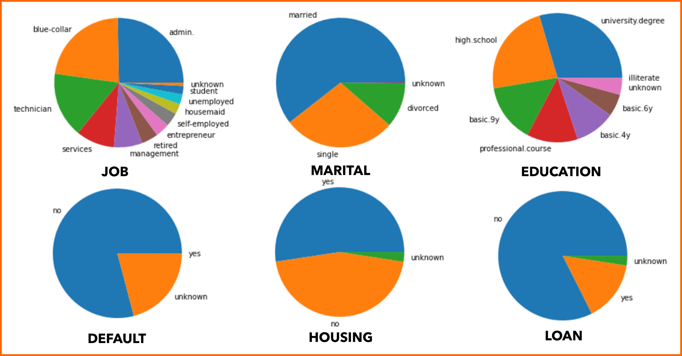
Exploratory Data Analysis
Notes:
This shows the distribution of the variables job, marital status, education, default, housing and loan.

Slide 9
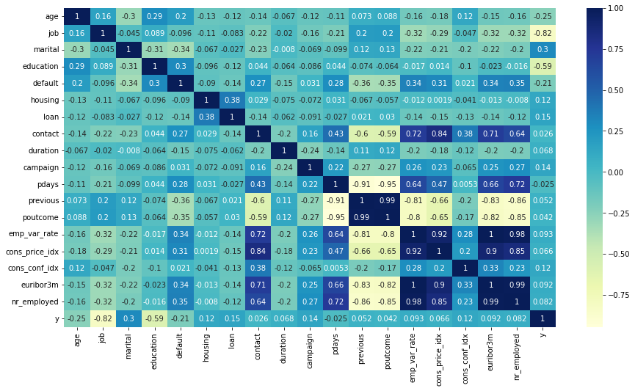
Correlation Plot
Notes:
The Correlation matrix shows that variables job and education may be negatively related to our target variable and higher the education, lesser the chance of the customer availing the term deposit. Also number of employees is may be positively influenced by the number of contacts, number of days since the last promotion and the price index.

Slide 10
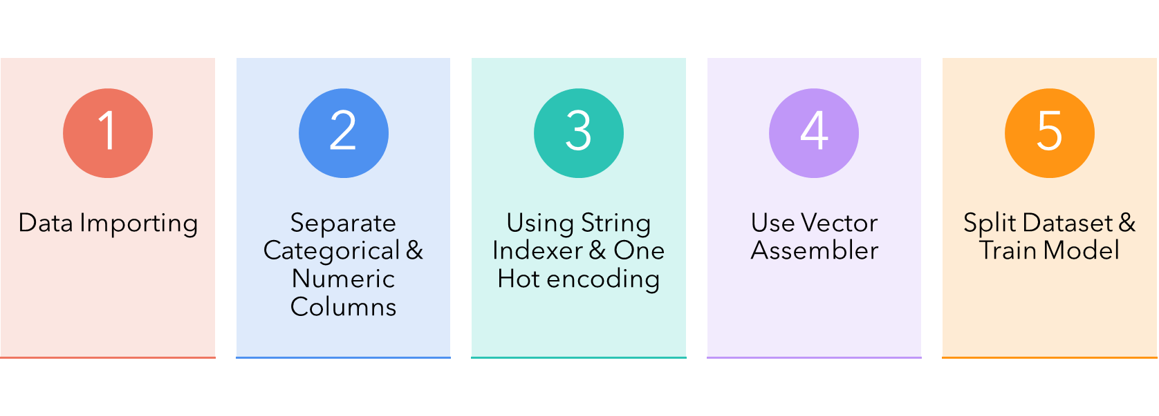
Model Preprocessing - Pipeline

Slide 11
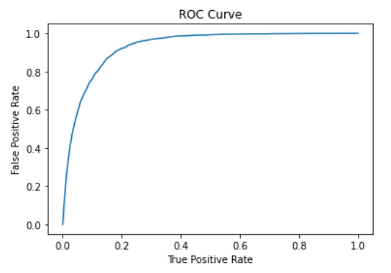
Model Comparison
 | Accuracy | AUC
Logistic Regression | 0.9117 | 0.9292
Decision Tree | 0.9076 | 0.5308
Linear Support Vector | 0.8674 | 0.9179
Naïve Bayes | 0.8427 | 0.5754
Random Forest | 0.8693 | 0.9251

Slide 12
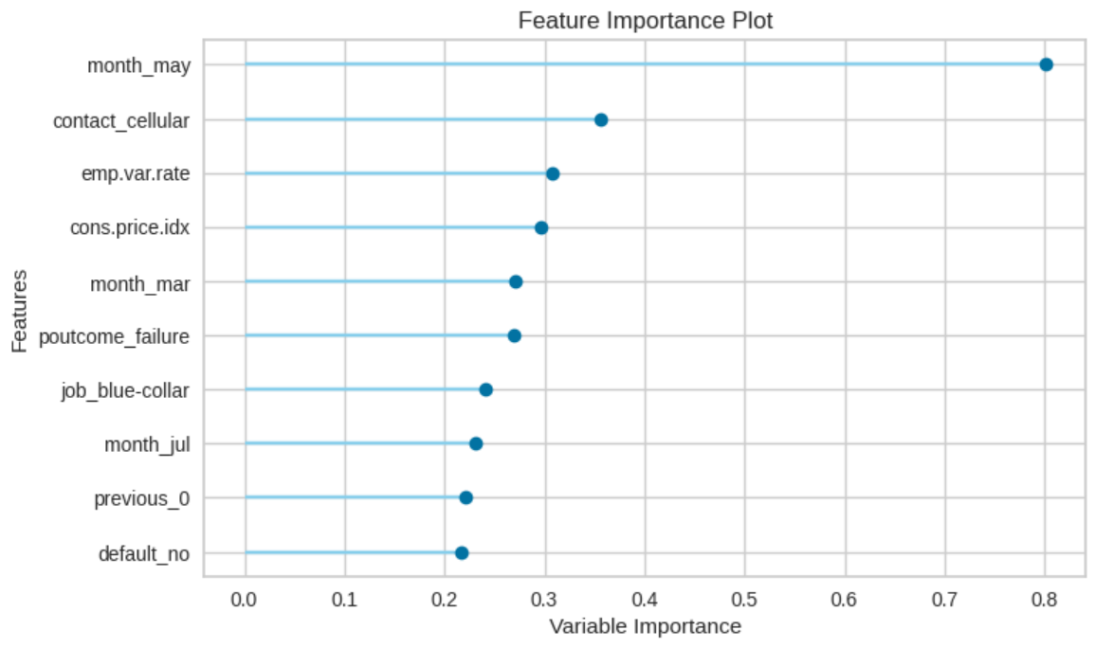
Feature Importance
Add text, images, art, and videos.
Add transitions, animations, and motion.
Save to OneDrive, to get to your presentations from your computer, tablet, or phone.
Notes:
As seen from the feature importance, the month of may is a important factor in determining term deposit conversions. This is followed by the device used by the consumer. The indicator of the consumer having a blue collar job is significant too. This can be used to target certain consumers.

Slide 13
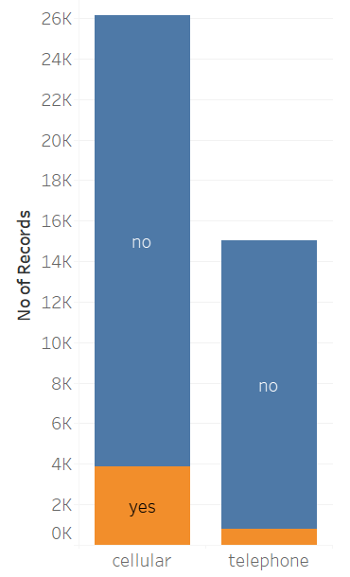
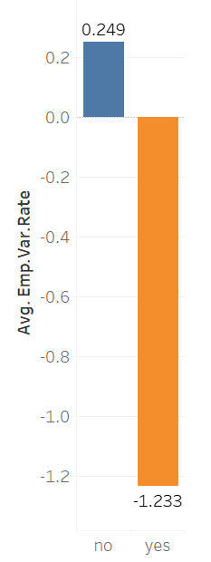
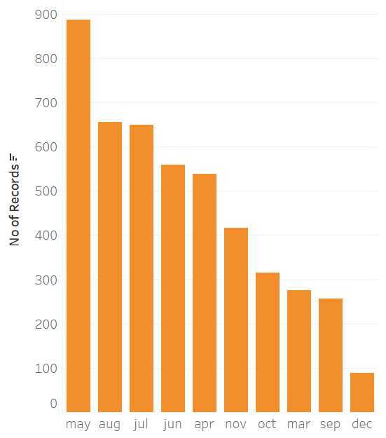
Insights
Clients who were communicated using a cellphone observed a higher degree of subscription
The average employment variance rate is lower for clients who subscripted
The campaigns observed a lot of subscription in month of May as compared to other months

Slide 14

Recommendations
Assuming the importance of clients that are willing to subscribe to the term deposit is higher we need to focus on recall to reduce the false negative rates
Campaigns carried in the month of May observed a higher rate of subscription
Engagement Time: The average call duration of clients who subscribed was 9.2 min vs 3.6 mins for ones who didn’t subscribe
Having a blue-collar job is good indicator to target consumers that are more likely to subscribe to a term deposit.

Slide 15
Thank you

